Slide 1
Wabash Capstone
Project Notes 06
By: John Danison

Slide 2
What Did I Say I Would Do This Week?
Refine Data Acquisition Strategy | Specifically, How Data Will Be Formatted
Have Sensors Picked & Documentation For Reasons Complete

Slide 3
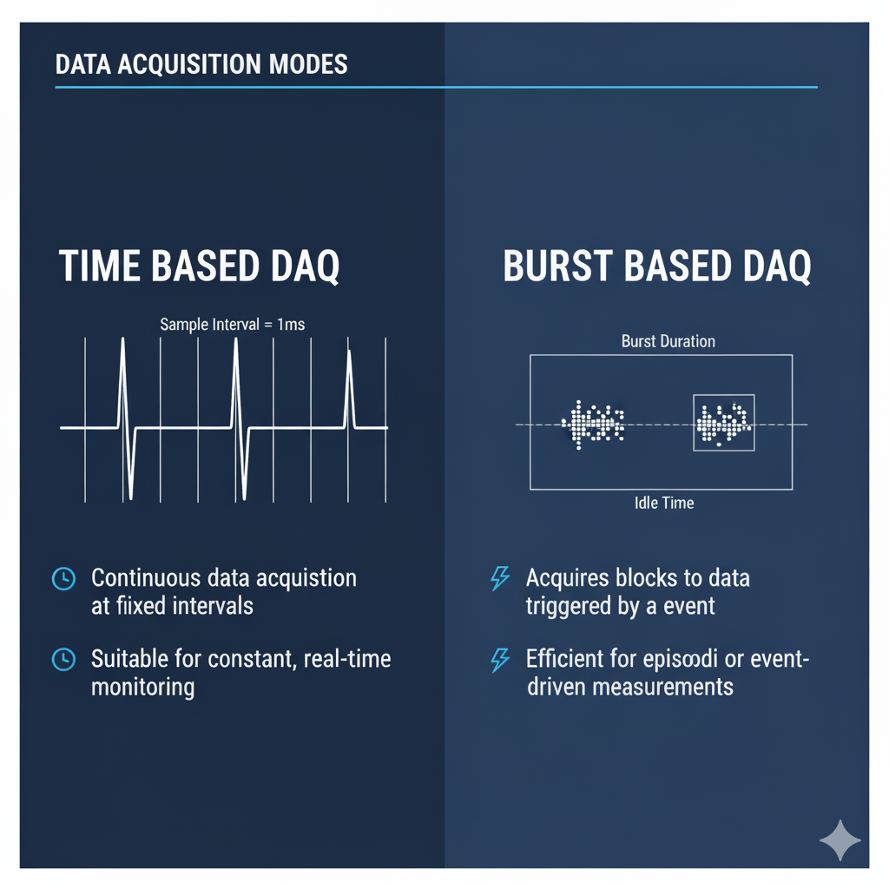
What I Have Done This Week Pt1.
Compared Data Acquisition Strategies
Parameter | Time-Based Acquisition | Burst-Based Acquisition
Sampling Trigger | Fixed interval (e.g., timer) | Event or condition-based
Data Rate | Uniform | Variable, bursty
Power Efficiency | Moderate to low | High (system sleeps most of the time)
Suitability | Slowly changing signals (Temp, RH) | Fast or transient signals (Accel, Strain)
Implementation Complexity | Low | Higher (requires event detection logic)
Data Volume | Constant | Reduced, but burst-heavy when active

Slide 4
What I Have Done This Week Pt2.
It appears that a Burst-Based DAQ strategy is most applicable for this application.
Most importantly, we have the space available to attempt this.
We can record the temperature & relative humidity once at the beginning of the burst data from the acceleration and strain gauge sensors. This bundles data into one large “event” for Wabash to use.
Parameter | Value / Calculation | Result
Sensors | 3-axis accel + 1 strain (high-rate) + Temp & RH (1 sample) | —
Sampling Rate (Accel/Strain) | 2,000 samples/sec | —
Data Format | 16-bit (2 bytes/sample) | —
Data Rate | 2,000 × 4 × 2 | 16 kB/s
Burst Duration | — | 2 s
Burst Size (Accel + Strain) | 16 kB/s × 2 s | ≈ 32 kB
Temp + RH Samples | 2 sensors × 2 bytes each | + 4 B
Total per Burst | 32 kB + 4 B | ≈ 32 kB
128 GB microSD Capacity | ≈ 137,000 MB | —
Bursts Storable | 137,000 MB ÷ 0.031 MB | ≈ 4.3 million bursts

Slide 5
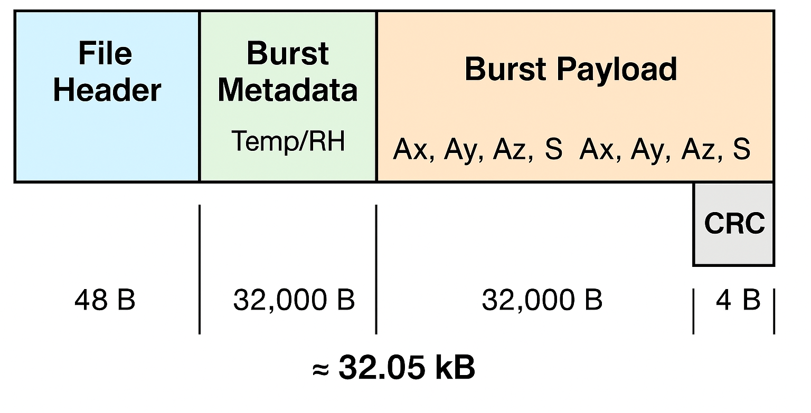

What I Have Done This Week Pt3.
Sample Data Packet / Entry:

Slide 6
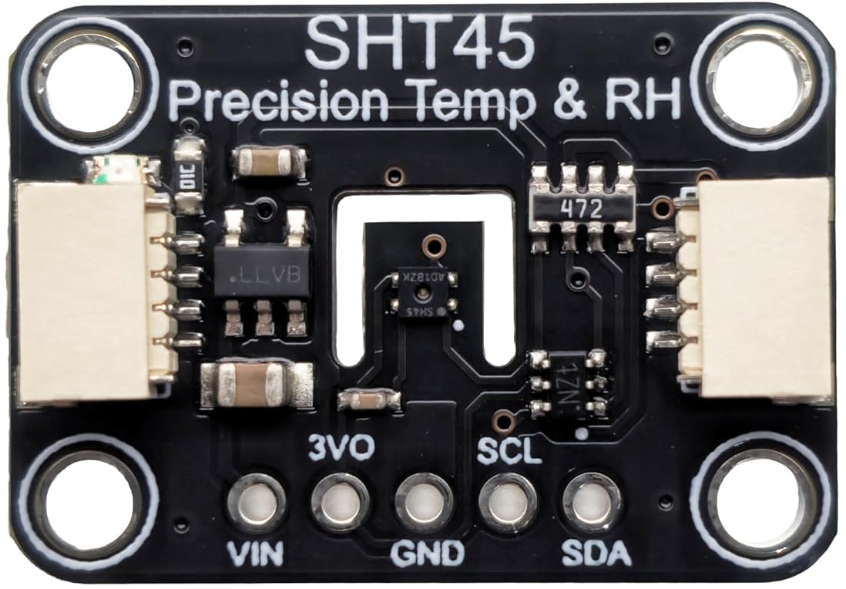
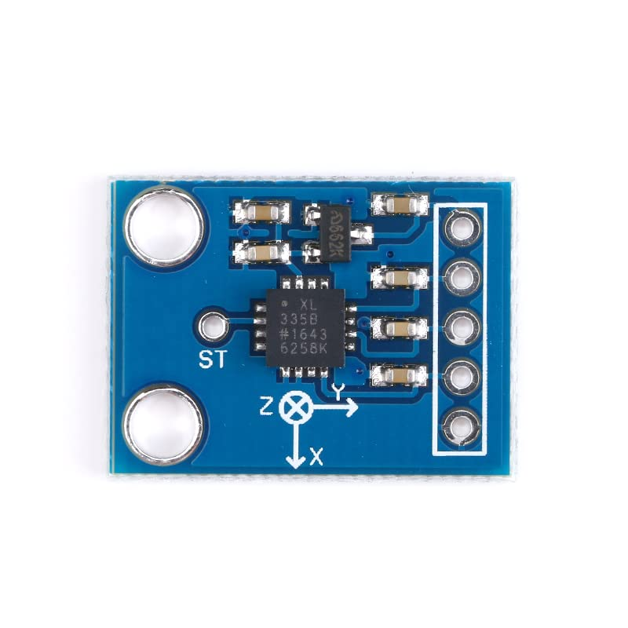
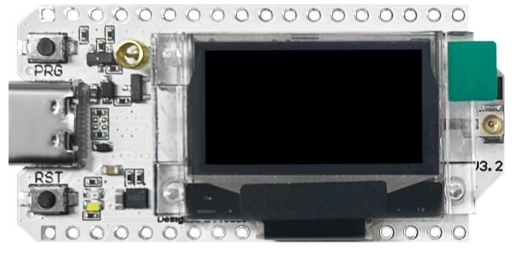
What I Have Done This Week Pt4.
Sensors Picked:
Temperature &
Relative Humidity:
SHT45
Acceleration / Vibration:
ADXL335
Microcontroller:
Heltec LoRa WiFi (V3)

Slide 7
Did I Do What I Say I Would Do?
I feel that I met my promises this past week. I have further brainstormed and laid out the storage packet and DAQ strategy.
I also created a BoM & sent it to Skylar for procurement.
I have attended every class.
I continue to lead the EE & DAQ of this project.

Slide 8
Plans For Upcoming Week
High Level
By EOW:
After the team goes on the manufacturing visit, we will pick the strain gauge the fits the physical requirements for the coupler.
Continue to research industry standard data acquisition methods and packet creation.
Find applicable strain gauge & ADC converter.
Create parts procurement to start prototyping process.
Attempt to setup a meeting with my internship mentor and ask about their data acquisition method for airplanes.

